Slide 1


MYSQL 5.7 TO 8.0 MIGRATION
PRESENTED BY:
DEEPAK NISHAD

Slide 2
OpsZilla Database Upgrade From MySQL 5.7 to MYSQL 8.0
Opszilla is a mid-sized e-commerce company selling electronics, clothes, and household goods in the U.S. and Canada.
Over time, a few tables in their MySQL database have grown to 1TB because of:
Millions of customer accounts – Storing user profiles and login details.
Tens of millions of orders – High sales volume filling up the database.
Large product catalog – Includes images, descriptions, and metadata.
Order tracking & payments – Logs for shipping, returns, and transactions.
Customer feedback & support – Reviews, ratings, and service tickets.

Slide 3

Problem Statement
Opszilla’s global operations require uninterrupted service—any database downtime risks sales, customer satisfaction, and support. Near-zero downtime migration is essential.

Slide 4
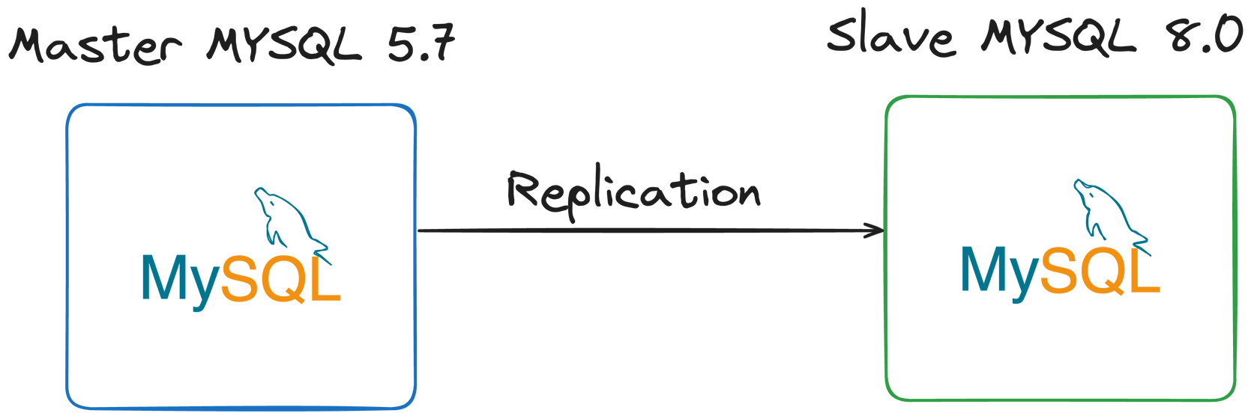
Solution
Use Case 1 : Primary Database Only (No Existing Replicas)
Set up a replica using MySQL dump/restore and replication: Take a consistent logical dump with mysqldump --single-transaction and capture the binlog position with SHOW MASTER STATUS before dumping.

Slide 5
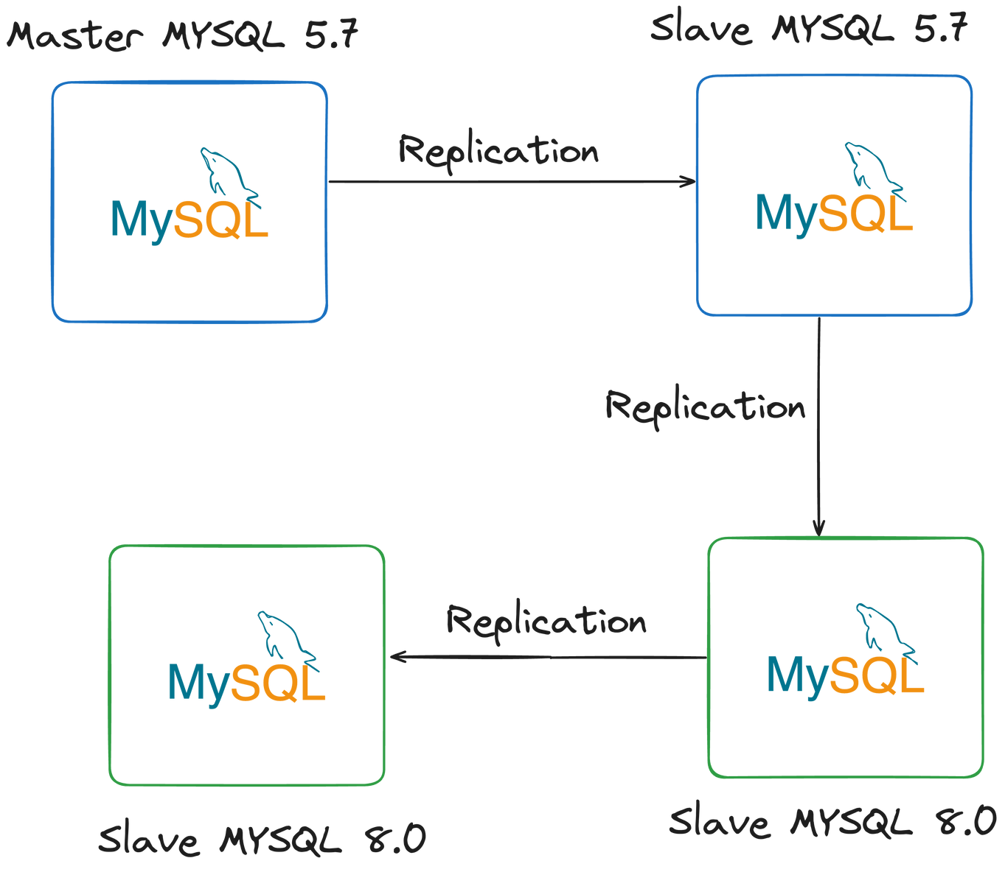
Solution
Use Case 2: Primary with Existing Secondary Replica
Offload Dumping to a Secondary Replica to Prevent Load on Primary : Use an existing read replica or create one temporarily from the master.

Slide 6
Recommendation
To ensure a reliable and monitorable migration process:
Break large tables data into chunks.
Avoids long table locks and transaction timeouts.
Minimize impact on production.
Allow monitoring and verification between chunks
Best Practices During Migration
Before performing the dump, set max_allowed_packet = 1G in both client and server configurations to prevent failures during dump and restore of large tables.

Slide 7
Identify Issue
CREATE TABLE `analysis_citations` (
`id` int(11) NOT NULL AUTO_INCREMENT,
`report_id` int(11) DEFAULT NULL,
`url` varchar(100) COLLATE utf8_unicode_ci DEFAULT NULL,
`rank` int(11) DEFAULT NULL,
`citation_link` varchar(2500) COLLATE utf8_unicode_ci DEFAULT NULL,
`citation_title` varchar(255) COLLATE utf8_unicode_ci DEFAULT NULL,
`url_host` varchar(150) COLLATE utf8_unicode_ci DEFAULT NULL,
`client_id` VARCHAR(255) CHARACTER SET utf8 COLLATE utf8mb3_unicode_ci NOT NULL,
`created_at` timestamp NULL DEFAULT CURRENT_TIMESTAMP,
`updated_at` TIMESTAMP DEFAULT CURRENT_TIMESTAMP ON UPDATE CURRENT_TIMESTAMP,
PRIMARY KEY (`id`),
KEY `report id` (`report_id`),
KEY `url host` (`url_host`)
) ENGINE=InnoDB AUTO_INCREMENT=81731627 DEFAULT CHARSET=utf8 COLLATE=utf8_unicode_ci;

Slide 8
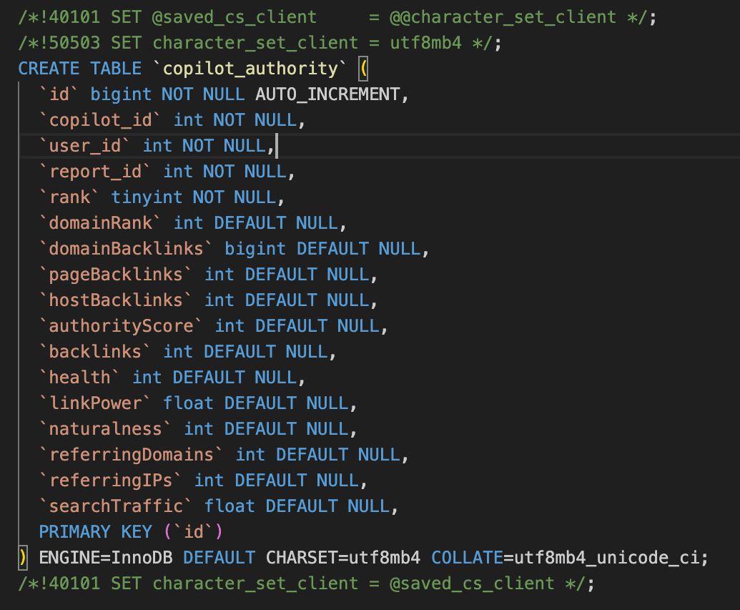
Problem Statement
MySQL 8.0 introduces new reserved keywords (RANK, SYSTEM, WINDOW, etc.), causing conflicts if used as column/table names in MySQL 5.7
Schema Restoration Failures: SQL imports may fail due to keyword conflicts.
Application Errors: Queries referencing reserved words break.
Replication Breakage: Replication setup may fail if reserved keywords are used in schema definitions.

Slide 9

Solution
Rename Problematic Columns ( ALTER TABLE table_name CHANGE `RANK` `user_rank` INT; )
Alter table without locking :-
Use Percona pt-online-schema-change utility
Use gh-ost utility
Reserved keywords in MYSQL 8.0

Slide 10
Recommendation
Update Application Code: Replace reserved keywords with alternatives.
Use gh-ost:
Zero-downtime migrations - Keeps your application running during the rename operations
Controlled cutover - Choose between automatic, manual, or timed cutover
Safe execution - Built-in throttling and load management
Reversible - Can abort the migration if issues are detected
Low-Traffic Window Deployment: Perform column alterations during periods of minimal traffic to reduce the impact on users and system performance.
gh-ost --host=10.0.40.5 --user=dba --password='secretpassword' --database=prod --table=analysis --alter="ALTER TABLE analysis CHANGE COLUMN \`rank\` url_rank INT DEFAULT NULL" --discard-foreign-keys --skip-foreign-key-checks --postpone-cut-over-flag-file=./ghost-postpone.flag --serve-socket-file=./ghost_migration.sock --approve-renamed-columns --chunk-size=1000 --allow-on-master --execute gh-ost.log

Slide 11
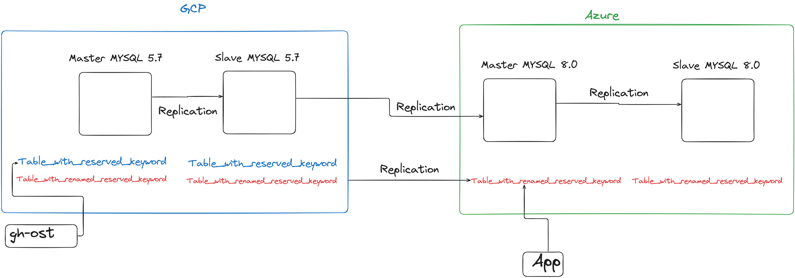
Alter table column in live database

Slide 12
Identify Issue
CREATE TABLE `order_delivery` (
`delivery_id` int(11) NOT NULL AUTO_INCREMENT,
`order_id` int(11) NOT NULL,
`customer_id` int(11) NOT NULL,
`status` enum('PROCESSING','SHIPPED','IN_TRANSIT','OUT_FOR_DELIVERY','DELIVERED') NOT NULL DEFAULT 'PROCESSING',
`order_date` timestamp NOT NULL DEFAULT CURRENT_TIMESTAMP,
`ship_date` timestamp NULL DEFAULT NULL,
`estimated_delivery` timestamp NULL DEFAULT NULL,
`actual_delivery` timestamp NULL DEFAULT NULL,
`carrier` varchar(20) DEFAULT NULL,
`tracking_number` varchar(50) DEFAULT NULL,
`last_updated` timestamp NOT NULL DEFAULT CURRENT_TIMESTAMP ON UPDATE CURRENT_TIMESTAMP,
PRIMARY KEY (`delivery_id`),
) ENGINE=InnoDB DEFAULT CHARSET=utf8mb4;

Slide 13
Problem Statement
When migrating the order_delivery table, you'll face several datetime-related challenges, particularly with the updated_at column that has ON UPDATE CURRENT_TIMESTAMP. Here are all the potential issues:
Auto-update Column Challenges: During migration, you need to ensure the updated_at column continues to auto-update when rows are modified.
Default Value Synchronization: Both created_at and updated_at have CURRENT_TIMESTAMP defaults . Need to ensure these defaults are preserved exactly in the target database.
Timezone Considerations: The timestamp columns are timezone-aware. If migrating between servers in different timezones, timestamps might shift unless handled properly.

Slide 14
Solution
Use native MySQL dump/restore for migration.
mysqldump includes the actual timestamp values from the source database
When restored on the replica, these exact timestamps are preserved
Change binlog_format to ROW to maintain data consistency
SET GLOBAL binlog_format = 'ROW';

Slide 15
Identify Issue
CREATE TABLE `customer_reviews` (
`review_id` int(11) NOT NULL AUTO_INCREMENT,
`product_id` varchar(50) CHARACTER SET latin1 DEFAULT NULL,
`customer_name` varchar(100) COLLATE utf8_general_ci DEFAULT NULL,
`review_text` text COLLATE utf8_unicode_ci,
`rating` tinyint(4) DEFAULT NULL,
`emoji_feedback` varchar(20) COLLATE utf8_unicode_ci DEFAULT NULL, -- ⚠️ Stores emojis (e.g., "👍", "😊")
`metadata` json DEFAULT NULL, -- ⚠️ JSON may contain 4-byte Unicode
`created_at` timestamp NULL DEFAULT CURRENT_TIMESTAMP,
PRIMARY KEY (`review_id`),
KEY `product_index` (`product_id`),
KEY `customer_index` (`customer_name`)
) ENGINE=InnoDB DEFAULT CHARSET=utf8 COLLATE=utf8_unicode_ci;

Slide 16
Problem Statement
OpsZilla is migrating its database from MySQL 5.7 to 8.0 to leverage performance improvements. However, the customer_reviews table contains mixed character sets (latin1, utf8) and relies on deprecated collations, risking data corruption during migration.
Truncated Emojis and Special Characters: The emoji_feedback column uses utf8_unicode_ci (3-byte), which cannot store 4-byte emojis (e.g., "😊" → "?").Existing emojis will be silently truncated during dump/restore.
Collation-Driven Query Failures: Mixed collations (utf8_general_ci for customer_name vs. utf8_unicode_ci for review_text) cause:
Illegal mix of collations errors in MySQL 8.0.
Inconsistent sorting in customer_index.
Legacy latin1 Columns: The product_id column uses latin1, which cannot map to UTF-8 equivalents (e.g., "Mëtäl" → corrupted).

Slide 17

What are Collation and Charset
Collation is like the "rule book" for how a database sorts and compares text
Whether letters are treated as uppercase or lowercase (case sensitivity)
How accented characters (like é, ñ) are handled
The order in which characters are sorted

Slide 18
Solution
Pre-Migration: Convert All Columns to utf8mb4 in the source MYSQL 5.7 database
ALTER TABLE `customer_reviews`CONVERT TO CHARACTER SET utf8mb4 COLLATE utf8mb4_0900_ai_ci ;
MySQL 5.7 Source | MySQL 8.0 Replica | Notes | Recommendation
utf8mb4 | utf8mb4 | ✅ Perfect | Ideal for new deployments
utf8 (utf8mb3) | utf8mb3 | ⚠️ Legacy | Temporary migration state
utf8mb3 | utf8mb4 | ⚠️ Conditional | Requires slave_type_conversions=ALL_NON_LOSSY
utf8mb4 | utf8mb3 | ❌ Dangerous | Data loss guaranteed

Slide 19
Recommendation
Pre-Migration Check: Identify tables with non-standard collations.
Standardize Collations: Ensure all databases use `utf8mb4_0900_ai_ci` where possible.
Backup Before Changes: Always take a backup before altering collations.

Slide 20
Use Case : Disk Space Constraints During Database Migration
Opszilla operates a 1TB MySQL database supporting millions of users, orders, and product listings. The company is planning a critical database migration, but faces a key constraint:
"We cannot increase disk capacity during migration due to budget/cost limitations."

Slide 21

Problem Statement
19/29
Binlogs Consume Excessive Disk Space – Uncontrolled log growth during migration can fill up the disk, causing:
"Disk Full" errors, halting migration mid-process.
Extended downtime, impacting customer transactions.
Post-Migration Storage Bloat – Leftover binary logs inflate storage costs unnecessarily.

Slide 22
20/29
Solution
Set aggressive log expiration: Automatically purges old logs to prevent disk filling
expire_logs_days = 0;
binlog_expire_logs_seconds = 3600; -- 1 hour retention

Slide 23
Optimizing InnoDB I/O Performance: innodb_flush_log_at_trx_commit
This critical InnoDB parameter determines how often transaction logs are flushed to disk, balancing durability and performance in MySQL/InnoDB.
Setting | Flush Behavior | Durability | Performance | Recommended Use Case
1 (Default) | Flush logs to disk on every transaction commit | Highest durability | Slowest | Production environments requiring full ACID compliance
2 | Flush logs to OS cache on commit, disk once per second | Moderate durability (survives OS crash but not power failure) | Faster | Data migrations/restores where speed is prioritized
0 | Write to OS cache, flush to disk once per second | Lowest durability | Faster | Temporary test environments only

Slide 24
Optimizing InnoDB I/O Performance: innodb_flush_method
This critical parameter controls how InnoDB interacts with the filesystem for data and log file operations, significantly impacting database performance during migrations and norml operations.
Method | Description | Durability | Performance | Recommended Use
fsync (default) | Uses fsync() for both data and log files | Highest | Slowest | General purpose, most compatible
O_DSYNC | Opens log files with O_SYNC (immediate sync) | High | Moderate | Rarely better than fsync
O_DIRECT | Bypasses OS cache for data files | High | Fast for writes | Recommended for most Linux systems
O_DIRECT_NO_FSYNC | Like O_DIRECT but skips final fsync | Risky | Fastest | Not recommended for production

Slide 25
Optimizing max_binlog_size to Reduce I/O Overhead During Large Migrations
When max_binlog_size is set too small (like your 100MB example), you experience:
Excessive file rotations - Creating new binlog files constantly
Increased metadata operations - More filesystem operations for creating/closing files
Filesystem contention - More frequent sync operations and directory updates
Increase max_binlog_size to Reduce Rotation Overhead : Larger binlog files = fewer rotations = less I/O contention:
max_binlog_size = 1G ;
Why? Reduces I/O overhead during restoration by minimizing rotations.
Revert after restoration as smaller logs are preferred for replication.

Slide 26
Recommendation
Optimal Settings for Database Migration/Restoration: For fastest possible migration while maintaining reasonable safety, use these settings:
innodb_flush_log_at_trx_commit:
innodb_flush_log_at_trx_commit = 2; -- Best balance for migrations
Why?
Faster than 1 (default) but safer than 0
Writes to OS cache first, flushes to disk every ~1 second
Survives OS crashes (but not power failures)
innodb_flush_log_at_trx_commit:
innodb_flush_method = 'O_DIRECT'; -- Best for Linux migrations
Why?
Bypasses OS cache, reducing double buffering
More efficient than fsync for bulk operations
Still maintains data integrity

Slide 27

Use Case : Migrating Users and Privileges from MySQL 5.7 to 8.0 for OpsZilla
OpsZilla wants to upgrade its MySQL database from 5.7 to 8.0 to leverage performance improvements, security enhancements, and new features. A critical part of this migration is ensuring that all users and their privileges are migrated exactly as they were in the old system to maintain security and access control.

Slide 28
Problem Statement
Different Default Authentication Plugins:
MySQL 5.7 uses mysql_native_password
MySQL 8.0 defaults to caching_sha2_password, which can cause authentication failures for apps not supporting it.
System Table Schema Changes: MySQL 8.0 restructures mysql.user (e.g., password → authentication_string, new role columns).
Failed User Imports: Direct mysqldump of users may not work.

Slide 29
Solution
Handle Authentication Plugin Compatibility : Set MySQL 8.0 to default to mysql_native_password:
# In my.cnf
[mysqld]
default_authentication_plugin=mysql_native_password
Manual SQL Extraction : Create a script to extract all users and their privileges from MySQL 5.7, and map them to MySQL 8.0-compatible user and privilege table schemas.

Slide 30
Recommendation
Audit Users Before Migration: List all users and privileges.
Test Authentication: Ensure applications can connect with new passwords.

Slide 31
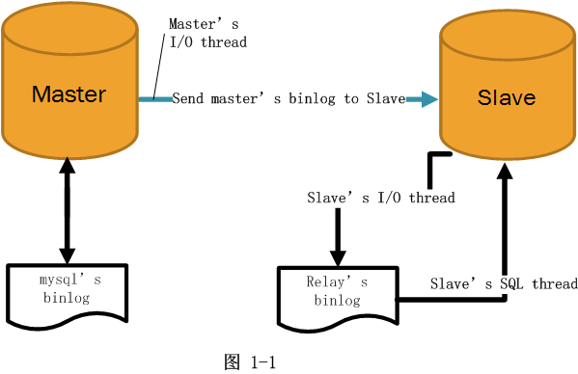
DEMO

Slide 32


MySQL Database Migration: Major Steps
Pre-Migration Optimization
Data Transfer
Post-Migration Steps
Pre-Migration Planning
Data Export
Data Import
Rollback Plan

Slide 33

Thank you
CONNECT WITH ME
E-mail
deepak.nishad@opstree.com
linkedin
@dnishad

